Slide 1


Slide 2
INTRODUCTION
This web application helps students and professionals find accommodation near the KIET Group of Institutions, offering real-time listings of rooms and PG. Users can search, filter, and browse based on location, price, and amenities, with added features like user reviews, ratings, and map integration for a seamless, efficient housing search experience.

Slide 3
Our Team and Mentorship
Team Members:-
Nitish Kumar Jha
Divye Gupta
Dolly Sharma
Jigyasa Tripathi
Mentor :-
Ms. Neelam Rawat
(Associate Professor)

Slide 4
Objective of the Project
The primary objective of this project is to develop a robust and user-friendly web application using the MERN stack (MongoDB, Express.js, React, Node.js) to simplify the process of finding rooms and PG accommodations near KIET Group of Institutions.
Centralized Platform: Create a hub for browsing accommodation options with search and filter features.
User Experience: Use React for a responsive, intuitive interface across devices.
Real-Time Updates: Implement Node.js and Express.js for live data management on listings and pricing.

Slide 5
Objective of the Project
Data Handling: Utilize MongoDB to efficiently store and retrieve accommodation details.
Advanced Features: Integrate user reviews, ratings, and map functionalities for informed decision-making.
Communication Tools: Provide contact forms for seamless interaction between tenants and landlords.
Scalability and Performance: Build a robust system to handle growth and maintain reliability.

Slide 6
PRESENTED BY :-
Resource Requirement of User
Basic Hardware:-
•Device: A computer, mobile phone, or tablet with sufficient processing power and memory.
•Operating System: A compatible operating system, such as Windows, macOS, Android, or iOS.
•Internet Connection: Access to a stable internet connection with adequate bandwidth.
Software:-
•Web Browser: An up-to-date web browser, such as Chrome, Firefox, Safari, or Edge.

Slide 7
PRESENTED BY :-
Resource Requirement of User
Accessibility:-
•Screen resolution: A minimum screen resolution is often not specified, but users with smaller screens might encounter layout issues.
•Visual acuity: Adequate vision to perceive elements on the screen.
•Input devices: Ability to use a mouse, keyboard, or touch screen to interact with the web app.
Additional Considerations:-
•JavaScript: Some web apps heavily rely on JavaScript, so JavaScript should be enabled in the browser.
•Cookies: cookies should be enabled in the browser.

Slide 8
PRESENTED BY :-
Software Requirements
Frontend: React (JavaScript)
Backend: Node.js, Express.js
Database: MongoDB
Frontend Styling: Material-UI or Bootstrap
APIs: Google Maps API (for map integration), custom REST APIs (for search, filter, listings)

Slide 9
PRESENTED BY :-
Software Requirements
Real-time Updates: WebSockets or similar protocols
Deployment Platforms: Vercel/Netlify (Frontend), Heroku/Render (Backend)
Database Hosting: MongoDB Atlas (Cloud)
Testing: Jest (for unit testing), Postman (for API testing)
Communication Protocols: HTTPS for secure data transmission
Version Control: Git/GitHub for code management

Slide 10
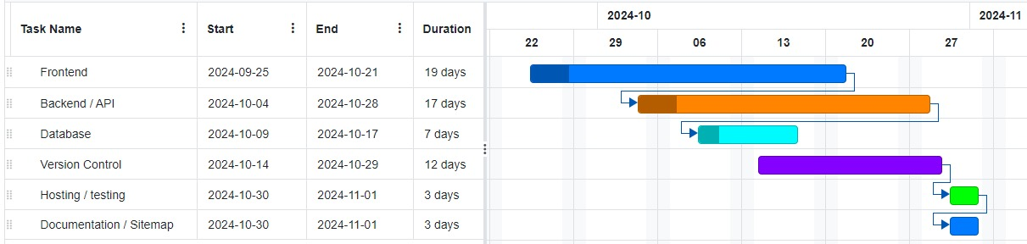
PRESENTED BY :-
Gantt Chart

Slide 11
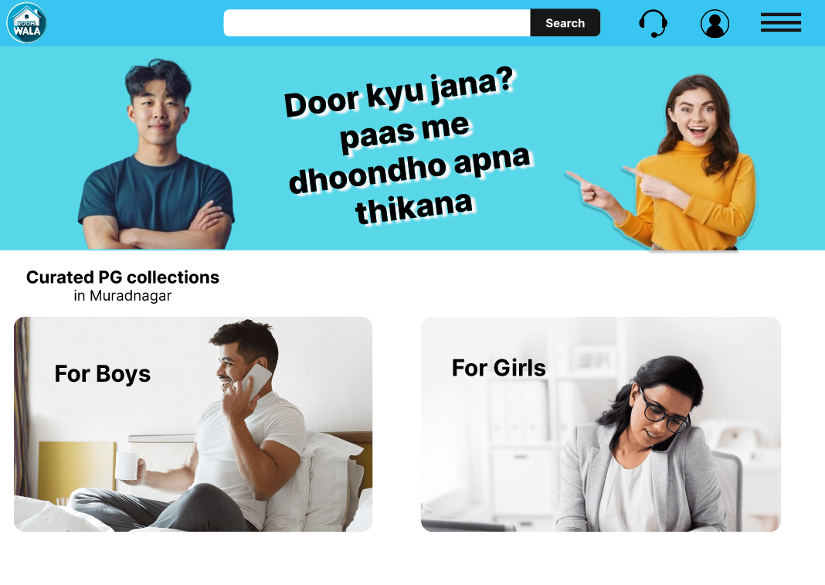
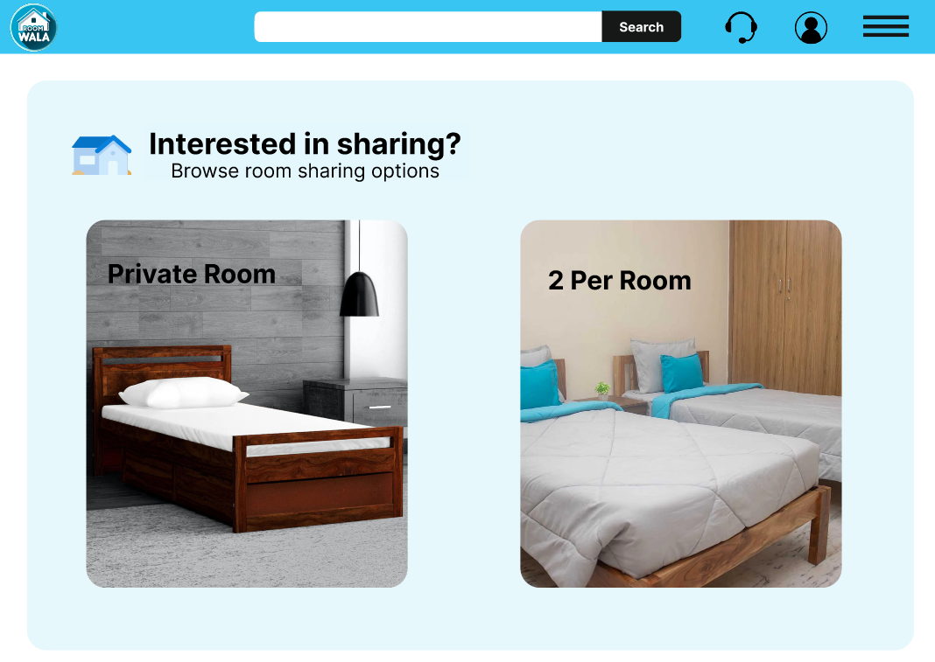
Expected Outcome

Slide 12
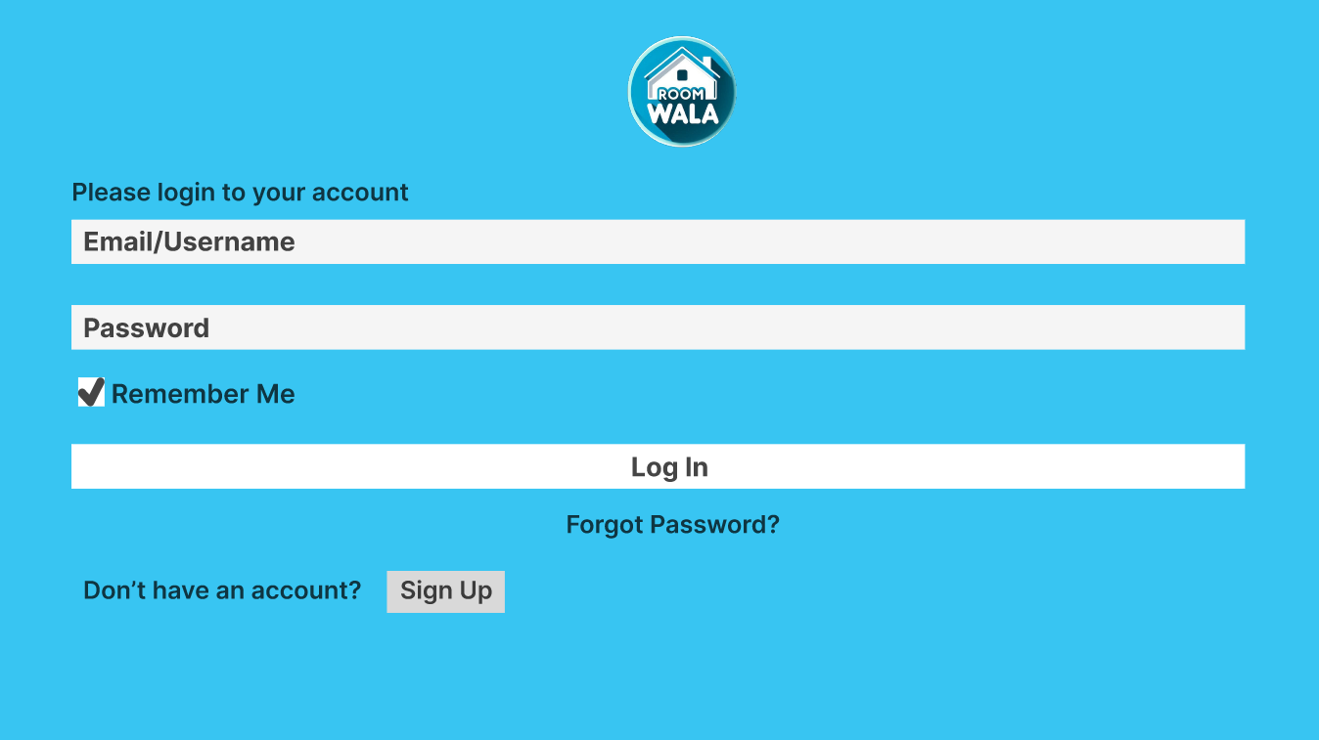
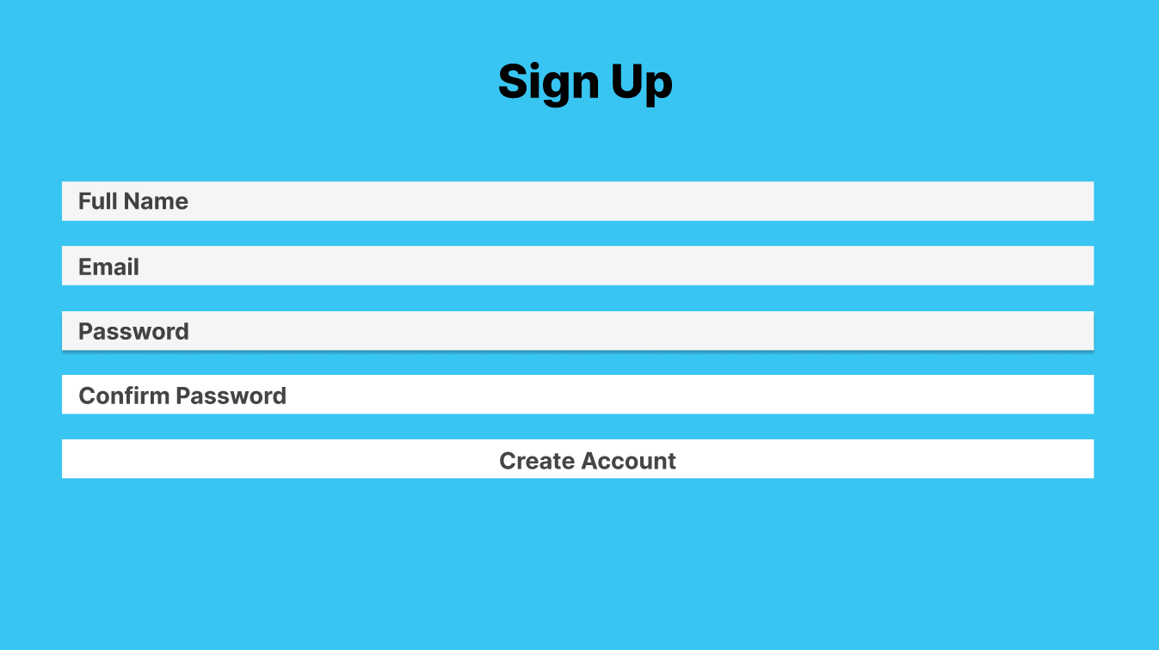
Expected Outcome

Slide 13
PRESENTED BY :-
Bibliography
1) Project Management: A Systems Approach to Planning, Scheduling, and Controlling by Harold Kerzner (2022). Wiley.
User Experience Design: A Practical Playbook to Fuel Business Growth by David W. Kadavy (2023). O'Reilly Media.
Smith, J., & Jones, A. (2022). "Impact of Project Management Software on Team Productivity." Journal of Project Management, 36(4), 45-58. https://doi.org/10.1016/j.jom.2022.03.002
4) Green, L., & Black, M. (2021). "Collaboration Tools in Remote Teams: A Systematic Review." International Journal of Human-Computer Studies, 89, 134-150. https://doi.org/10.1016/j.ijhcs.2021.03.005
5) Gartner. (2023). Magic Quadrant for Project Management Software. Retrieved from Gartner

Slide 14
THANK YOU

